Slide 1


Association Rules Mining

Slide 2
Reference
R. Agrawal, T. Imielinski, and A. Swami. Mining association rules between sets of items in large databases. In Proceedings of the ACM SIGMOD International Conference on Management of Data, pages 207-216, Washington D.C., May 1993
R. Agrawal and R. Srikant. Fast algorithms for mining association rules in large databases. In Jorge B. Bocca, Matthias Jarke, and Carlo Zaniolo, editors, Proceedings of the 20th International Conference on Very Large Data Bases, VLDB, pages 487-499, Santiago, Chile, September 1994

Slide 3

TABLE OF CONTENT
01
Introduction
02
Formal statement & Decomposition
03
Apriori Algorithm
04
Conclusion

Slide 4
Introduction
Retail organizations have a massive amounts of sales data, referred to as the basket data.
From that data, how can we know the associations between items bought in a transaction?
In 1993, Rakes Agrawal proposed a method called: Association Rules Mining.

Slide 5
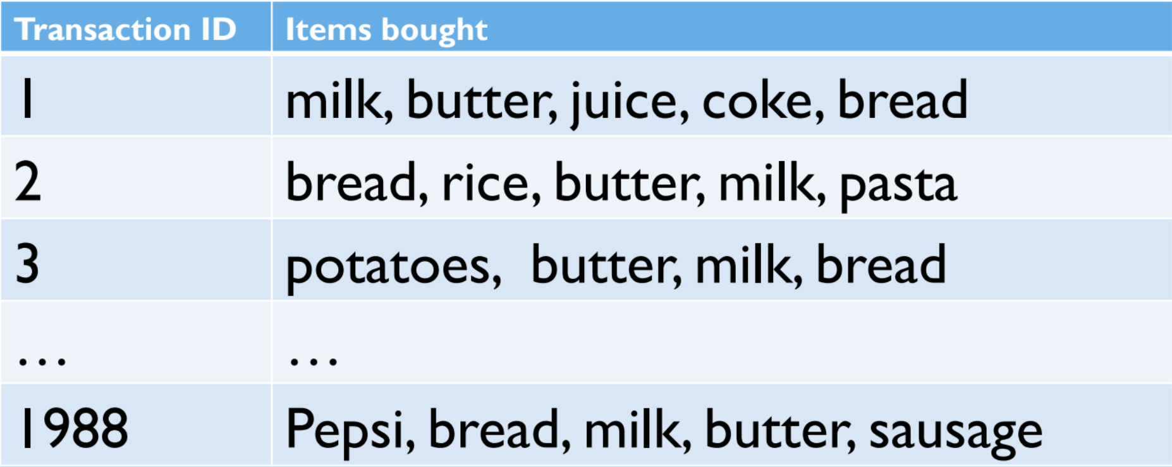

Introduction
An association rule is: [Butter, Bread] ⇒[Milk]

Slide 6
Formal statement & Decomposition
Set of items: I = {i₁, i₂, i₃, …, iₙ}
Transaction: (TransacId, T): T ⊆ I
Itemset, k-itemset: X, Y ⊆ I
Association rule: X ⇒ Y : X ∩ Y = Φ
Support
Support of the itemset X: Number of transactions that contain X
Support of the rule X ⇒ Y: Support of X ∪ Y

Slide 7

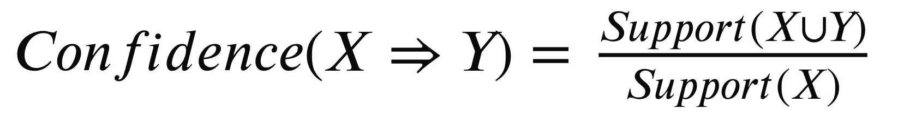
Formal statement & Decomposition
Confidence
Association rule mining: Generate all association rules that have support and confidence greater than the user-specified minimum support (minSup) and minimum confidence (minConf), respectively.

Slide 8
Formal statement & Decomposition
Association Rules Mining can be decomposed into 2 sub problems:
Sub problem 1: Finding all frequent itemsets.
X is a frequent itemset ⇔ Support(X) >= minSup
X is a frequent itemset ⇔ All subsets of X are frequent itemsets.

Slide 9
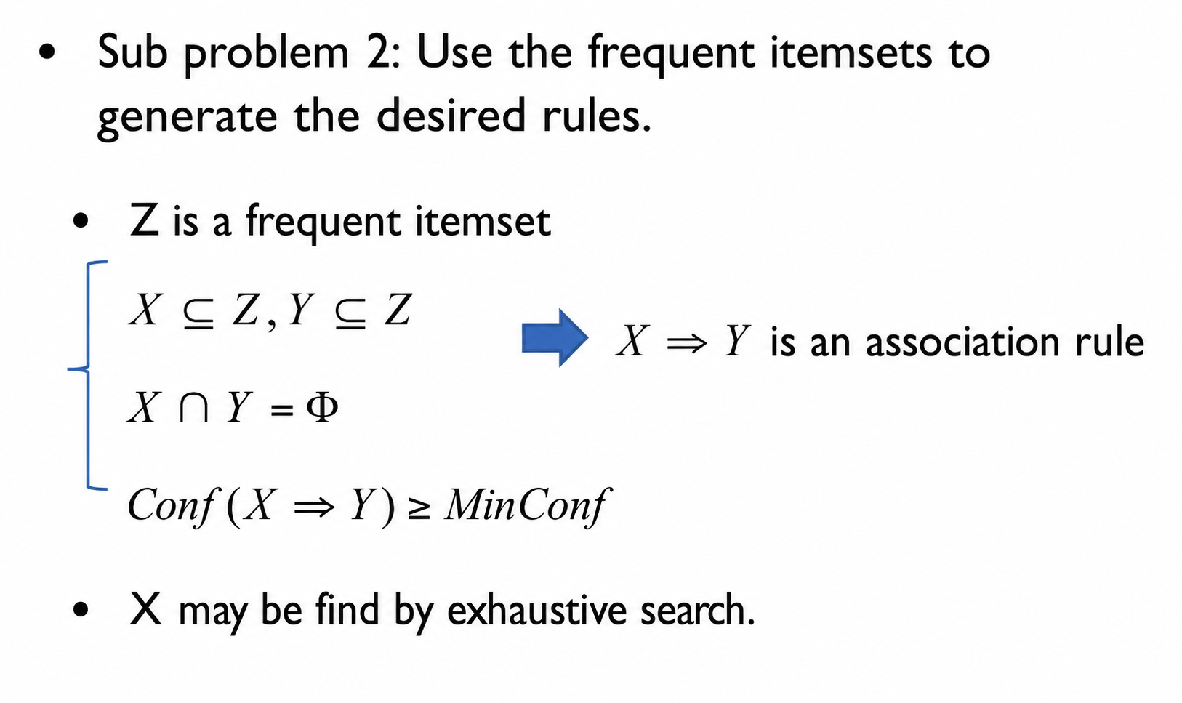
Formal statement & Decomposition

Slide 10
Outline
Introduction
Formal statement & Decomposition
Apriori Algorithm
Conclusion

Slide 11
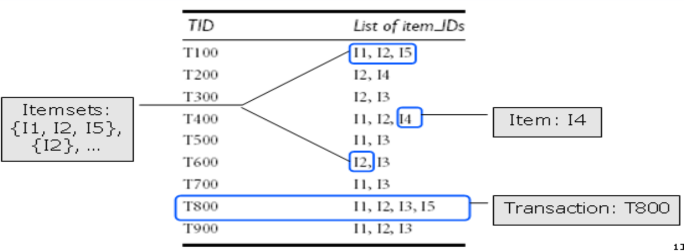
Apriori Algorithm - Concepts
X is frequent iff support(X) >= min_sup
Ex: min_sup = 3/9, =support{I1, I2} = 4/9. So {I1, I2} is frequent
X is a k-itemset iff X has k items
Ex: {I1, I2, I5} is a 3-itemset

Slide 12
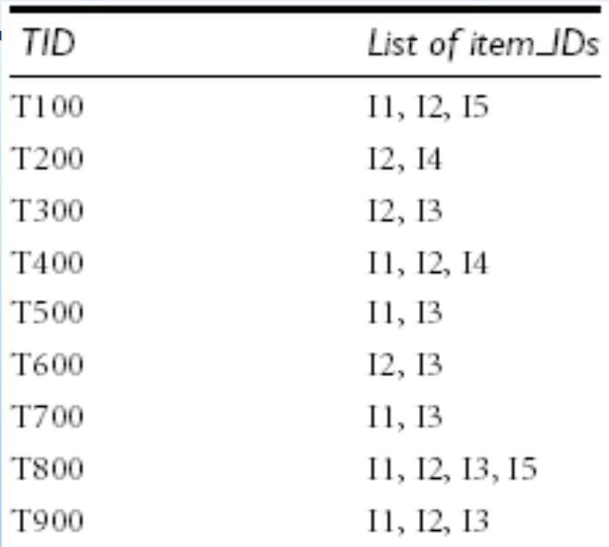
Apriori Algorithm - Purpose
Find all k-itemsets having support >= min_sup
k = 1, 2, ..., 5

Slide 13
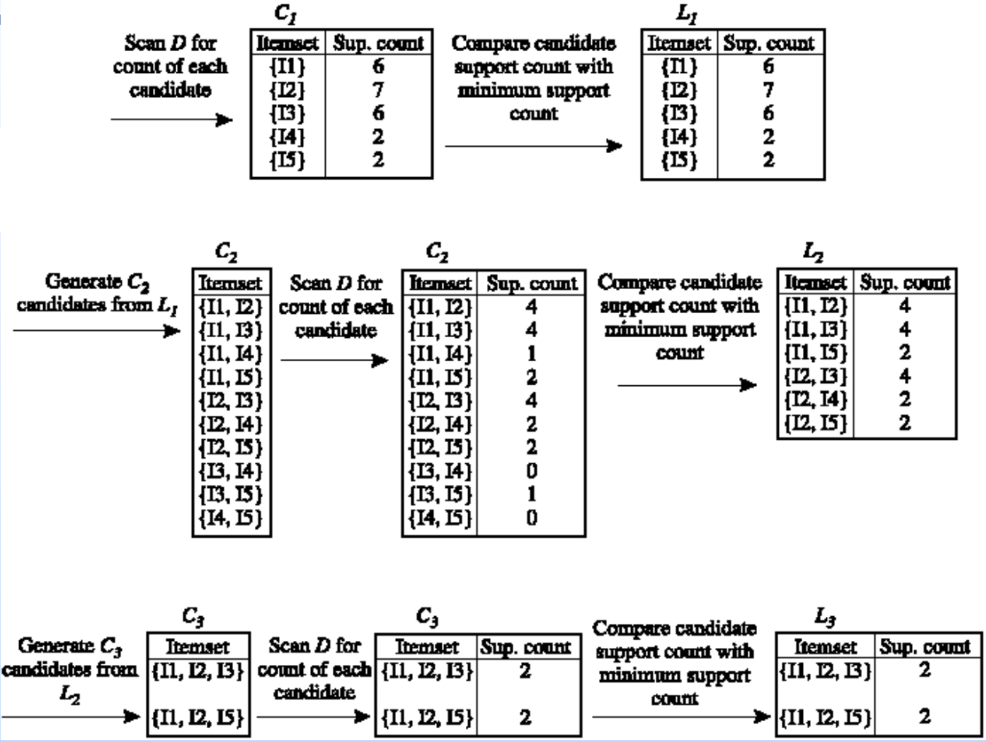
Apriori Algorithm – Step by Step
min_sup = 2/9
minimum support count = 2

Slide 14
Apriori Algorithm - Properties
Use prior knowledge
Apriori property: All nonempty subsets of a frequent itemset must also be frequent
Iterative search for frequent itemsets
Compute k+1-itemsets from k-itemsets

Slide 15
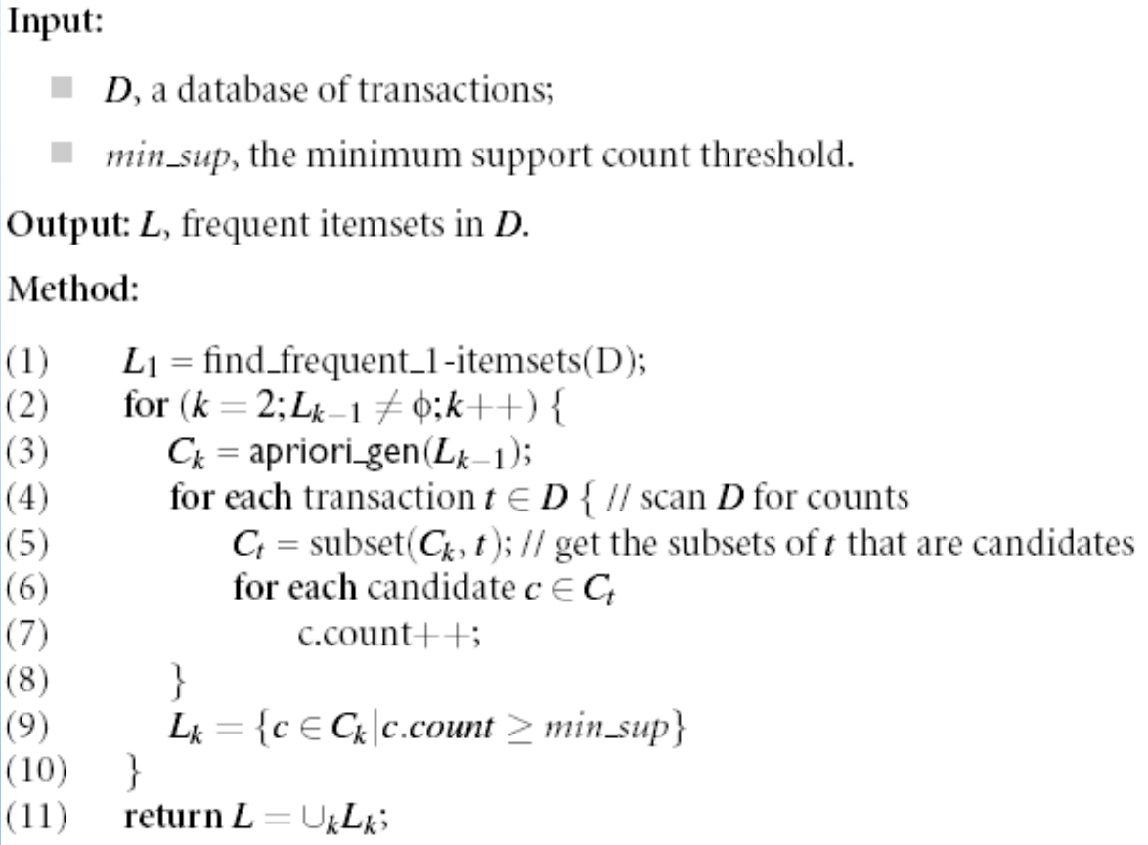
Apriori Algorithm - Methods
• • • •
•

Slide 16
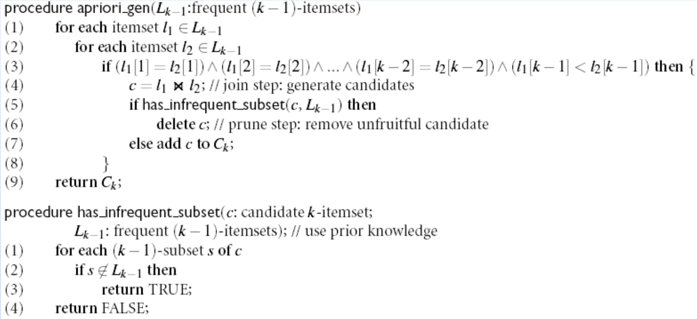
Apriori Algorithm - Methods

Slide 17
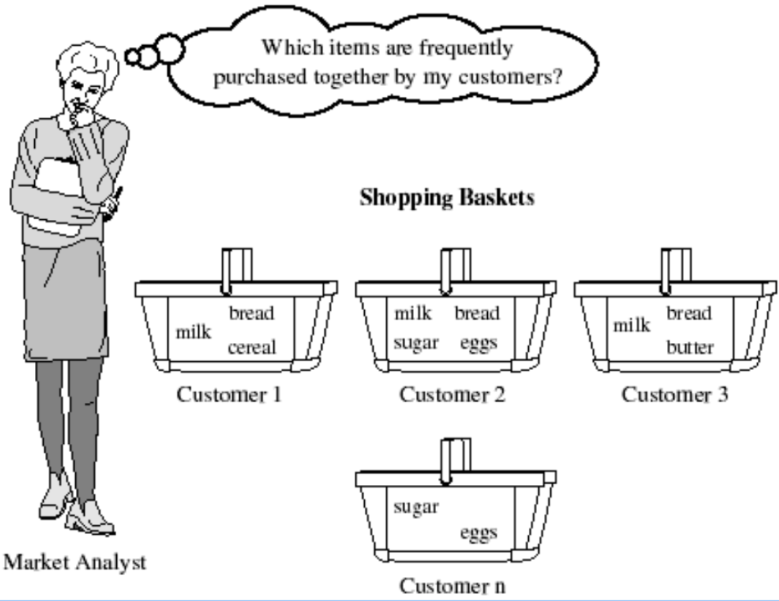
Conclusion
Case Study 1 – Market Basket Analysis

Slide 18
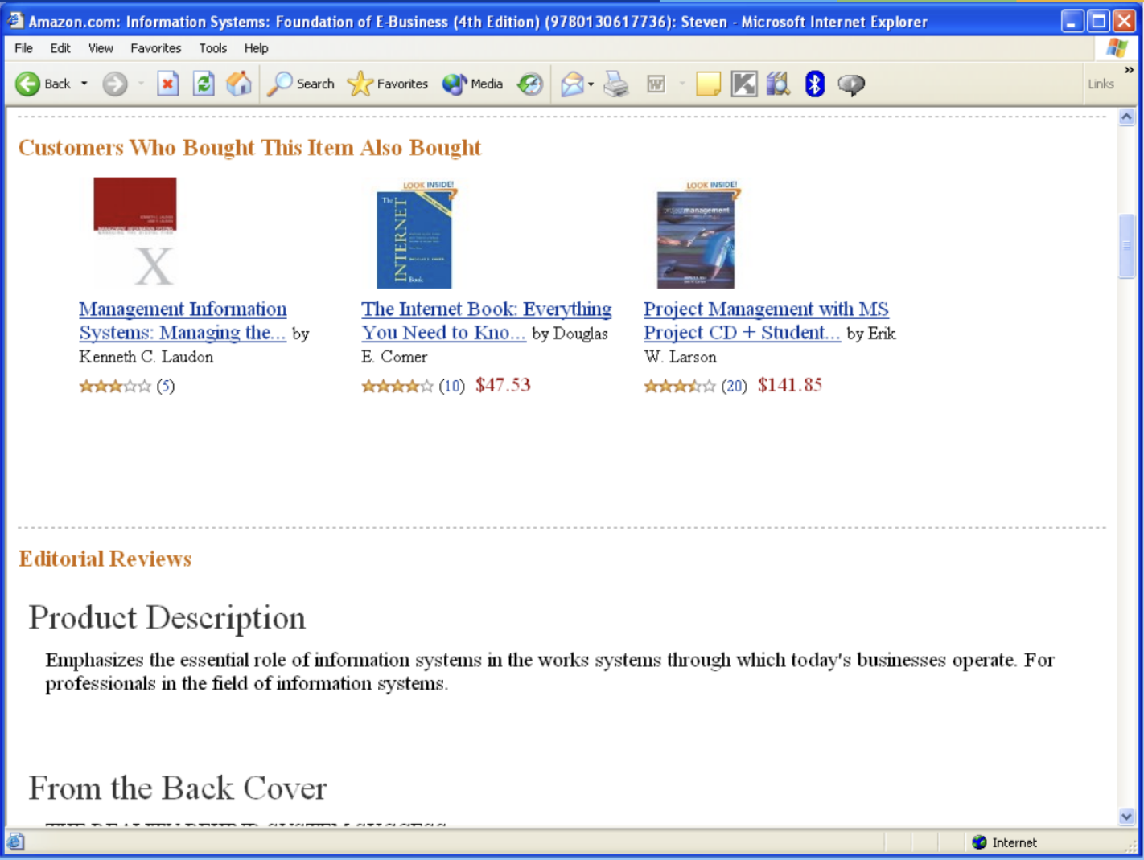
Case Study 2 – Related Products

Slide 19
Other applications
Catalog design
Classification
Clustering

Slide 20
Thank you for
your attention

